Slide 2
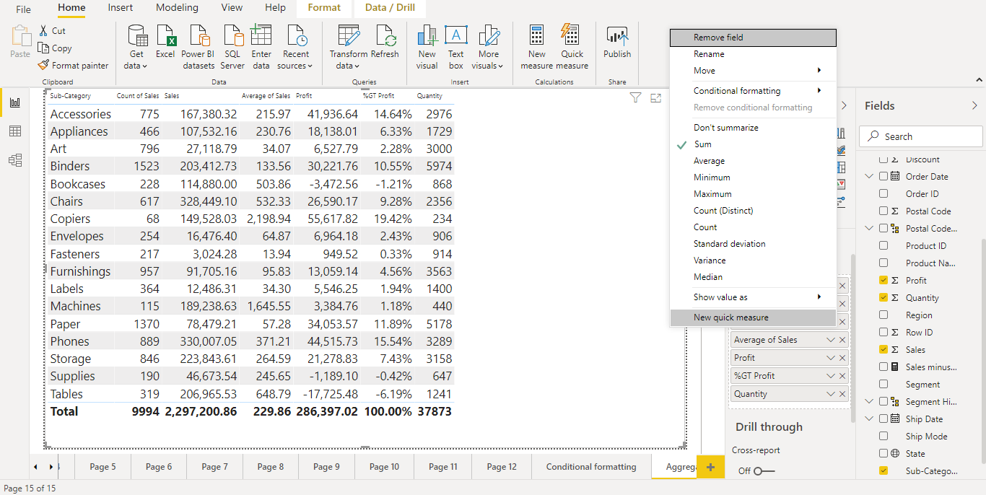

Tabular Data in Power BI -Table Aggregation
The default aggregation is sum, which can be changed to Avg, Count, etc.

Slide 3
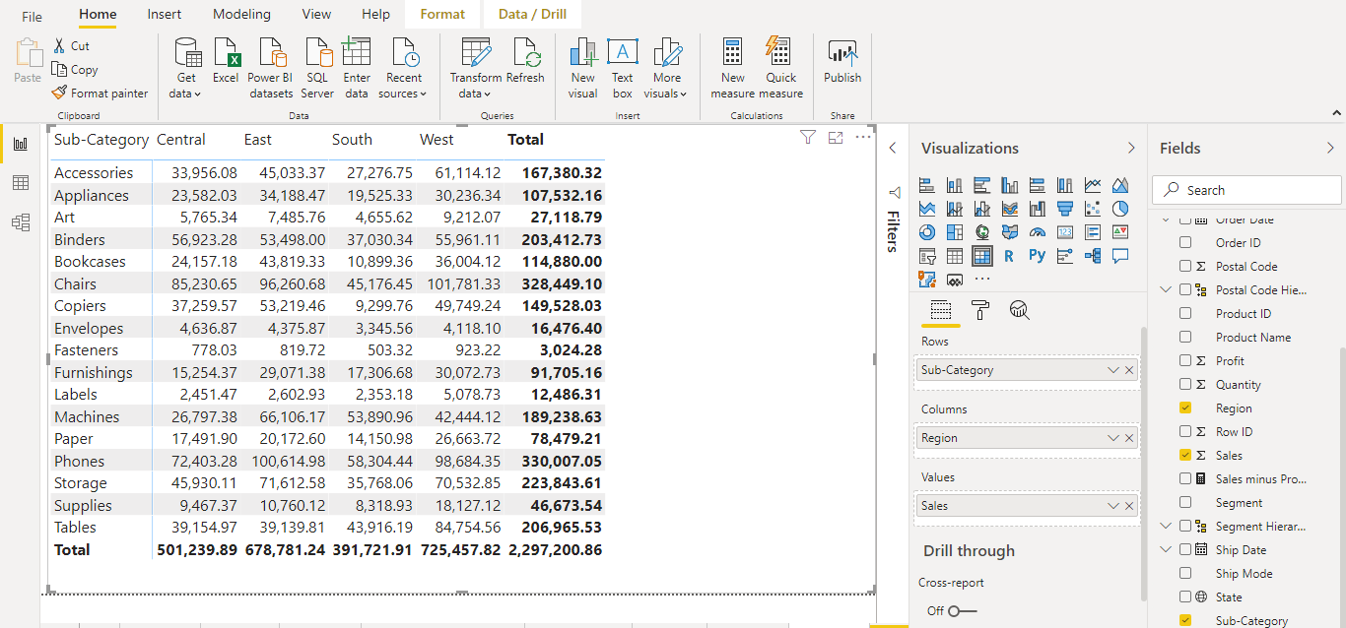
Tabular Data in Power BI-Matrix
The matrix is similar to a table. In table duplicate values are displayed and not aggregated. A matrix makes it easier to display data meaningfully across multiple dimensions -- it supports a stepped layout. The matrix automatically aggregates the data and enables drill down.

Slide 4
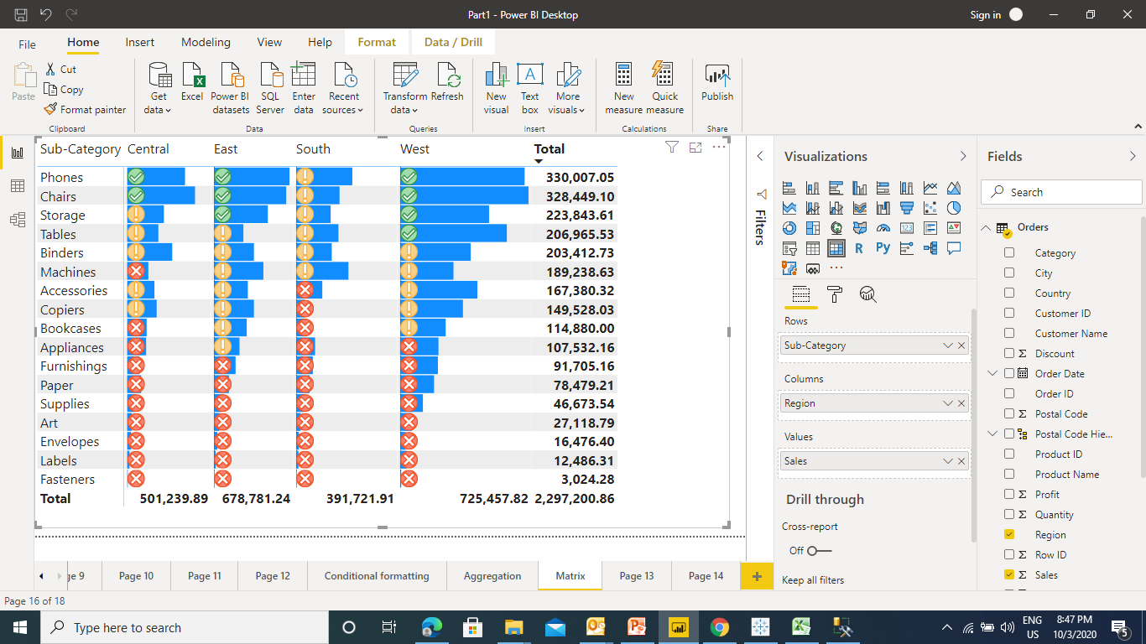
Tabular Data in Power BI-Matrix
Conditional formatting matrix.

Slide 5
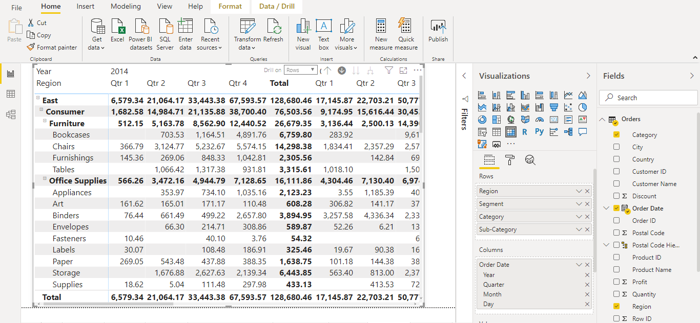
Tabular Data in Power BI- Matrix Hierarchies
Hierarchies gives expand & collapse feature to a field. You just need to drop one field over another to get the hierarchy

Slide 6
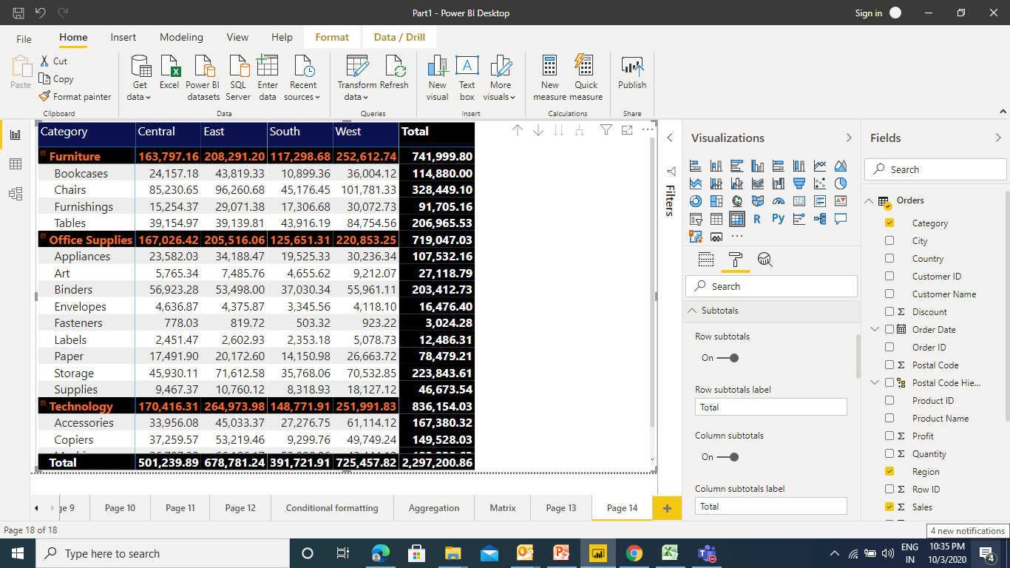
Tabular Data in Power BI- Matrix Formatting Totals

Slide 7
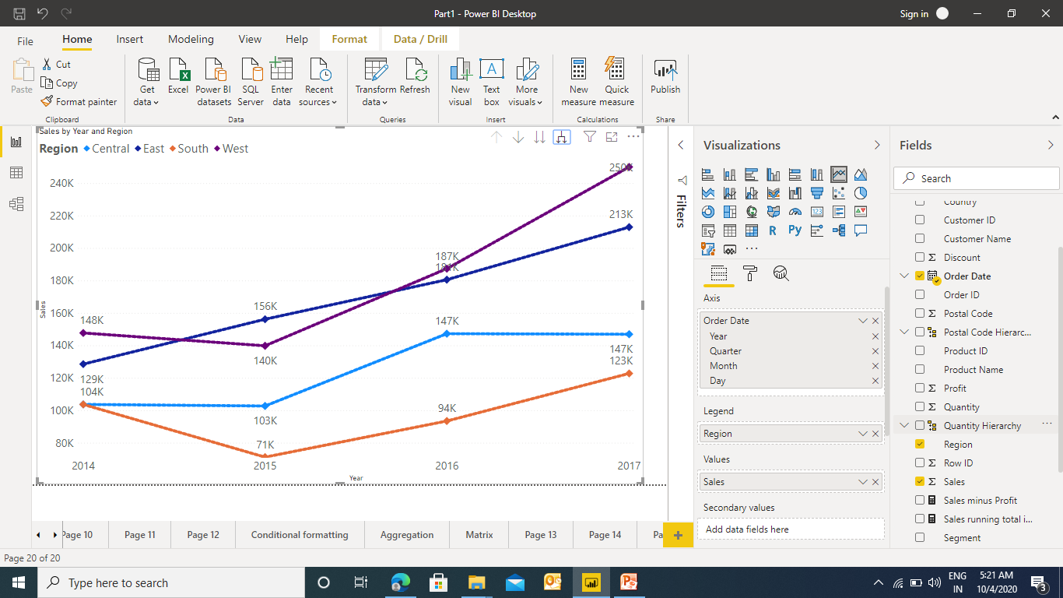
Line Chart in Power BI
To create a line chart we need to have a date field

Slide 8
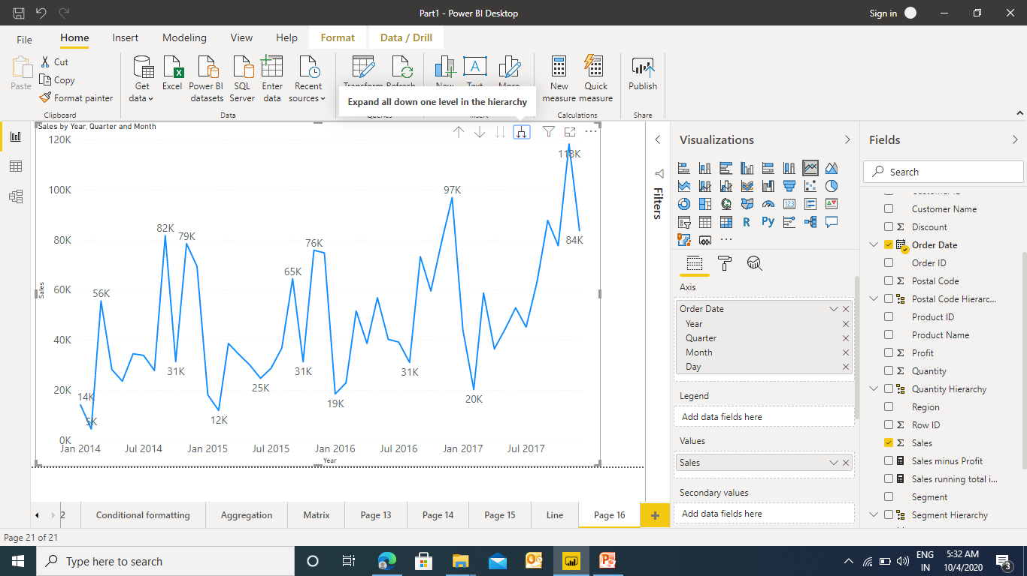
Line Chart in Power BI
As the date field has been used in Line Chart it also gives the feature of Auto Hierarchy

Slide 9
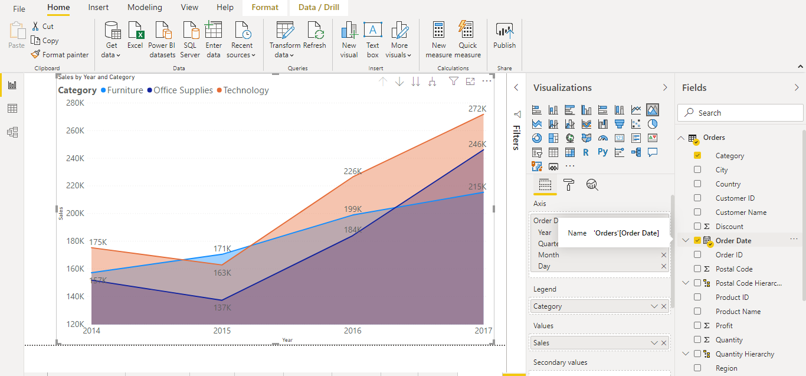
Area Chart in Power BI
Area Chart is the enhancement of line chart where the area below the line is filed

Slide 10
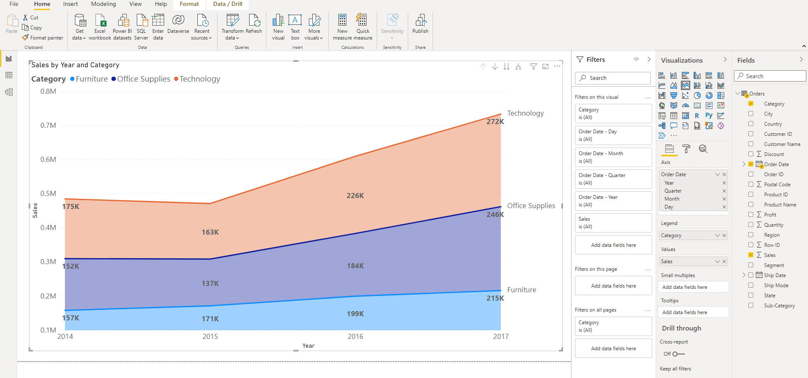
Stacked Area Chart in Power BI
Area Chart is the enhancement of line chart where the area below the line is filed

Slide 11
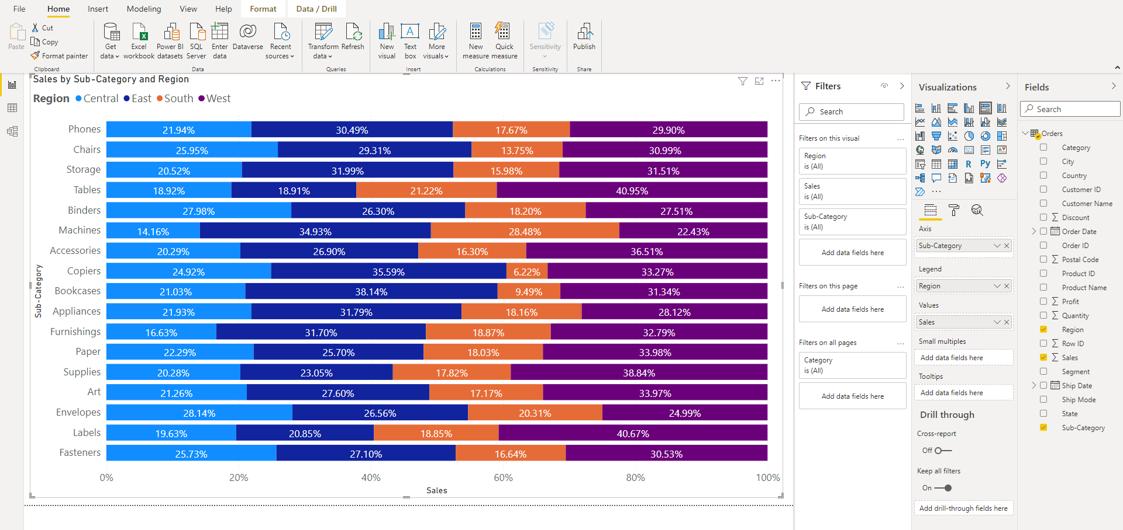
Basic Charts in Power BI –100% Stacked Bar Chart

Slide 12
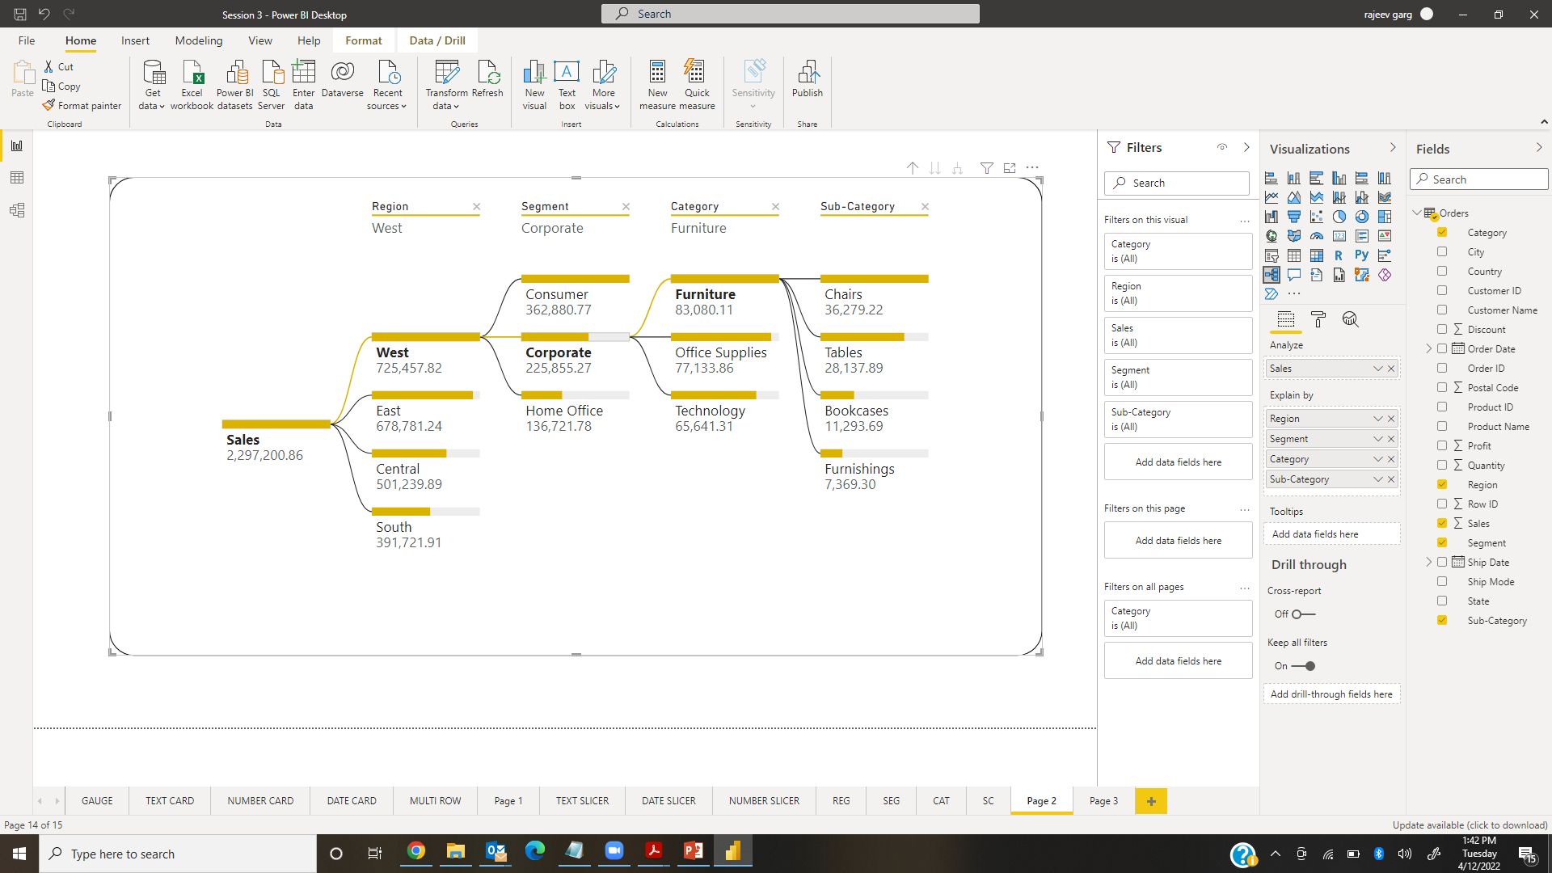
Basic Charts in Power BI – Decomposition Tree

Slide 13
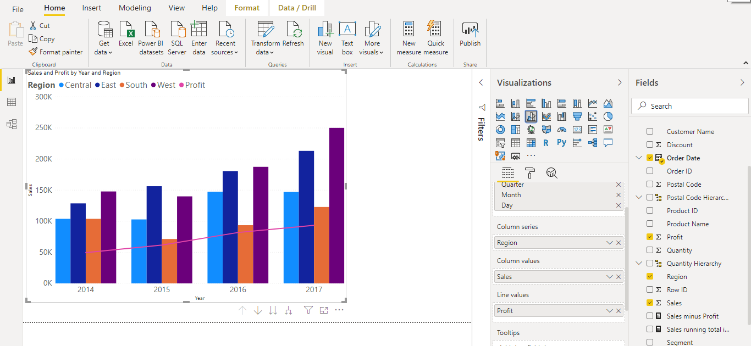
Combo Chart in Power BI
Combo Chart is a combination of Line & Column chart. Also be considers as dual axis chart. It is used to compare the two measures . Line & Clustered Column

Slide 14
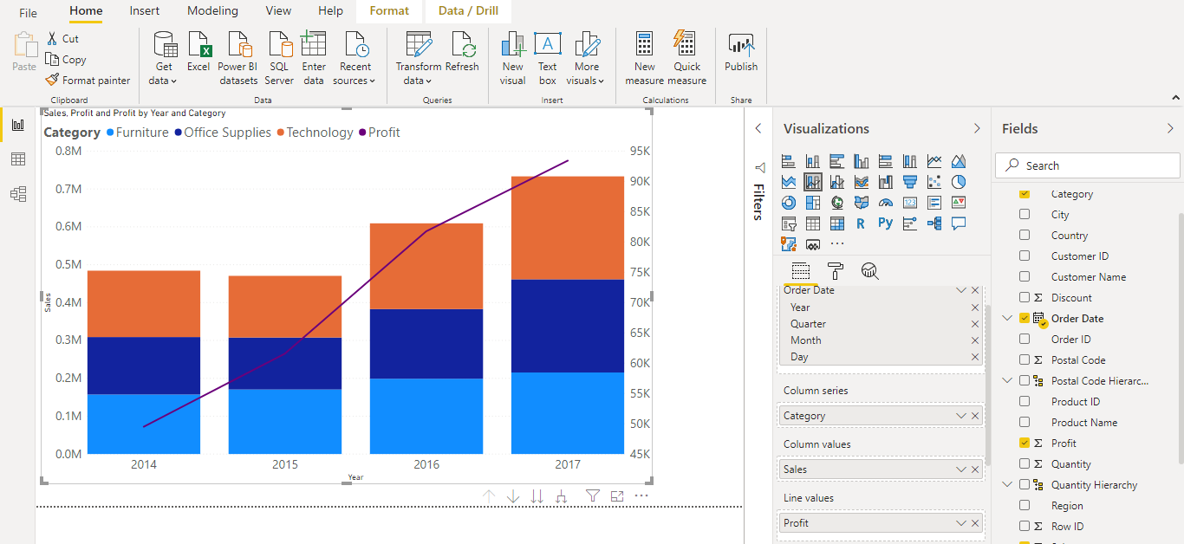
Combo Chart in Power BI
Combo Chart is a combination of Line & Column chart. Also be considers as dual axis chart. It is used to compare the two measures . Line & Stacked column

Slide 15
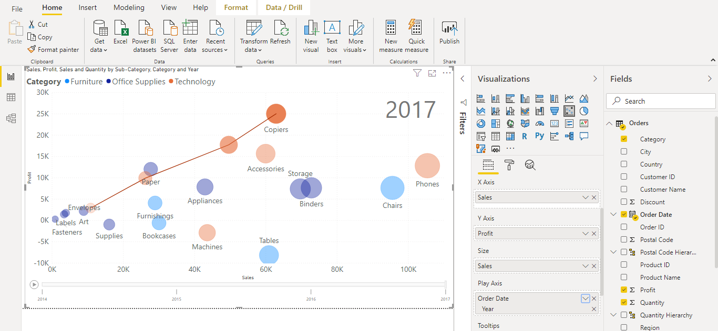
Scatter Chart in Power BI
Scatter chart is used to compare the two numeric files (measures) . It is the only default animation chart in Power BI.

Slide 16
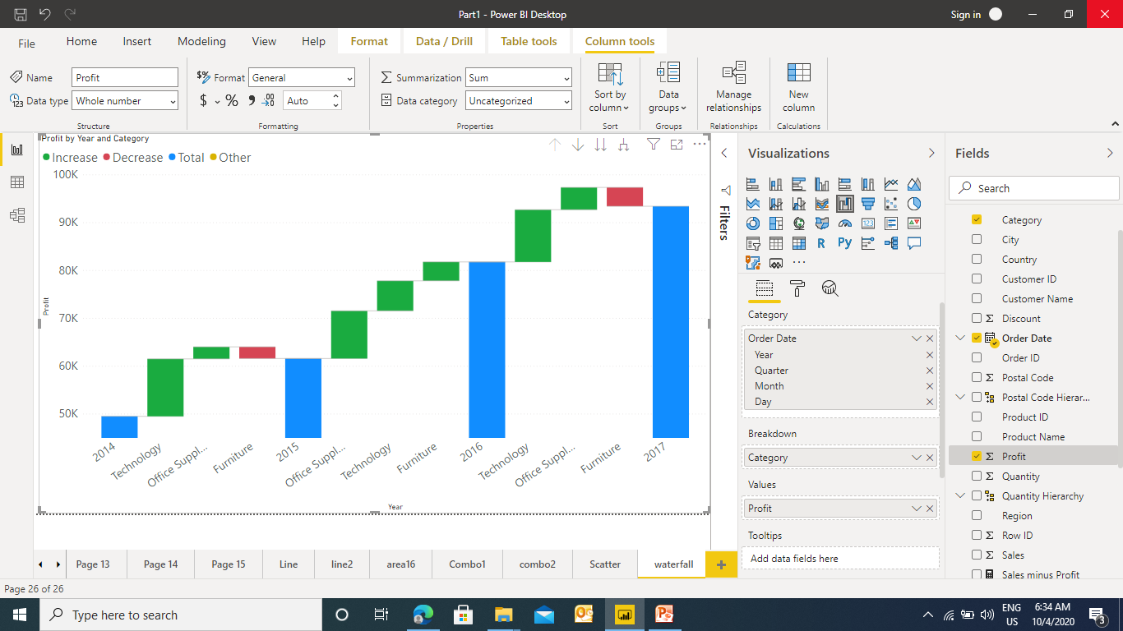
Waterfall Chart in Power BI
Waterfall chart is useful when we want to display the trend

Slide 17
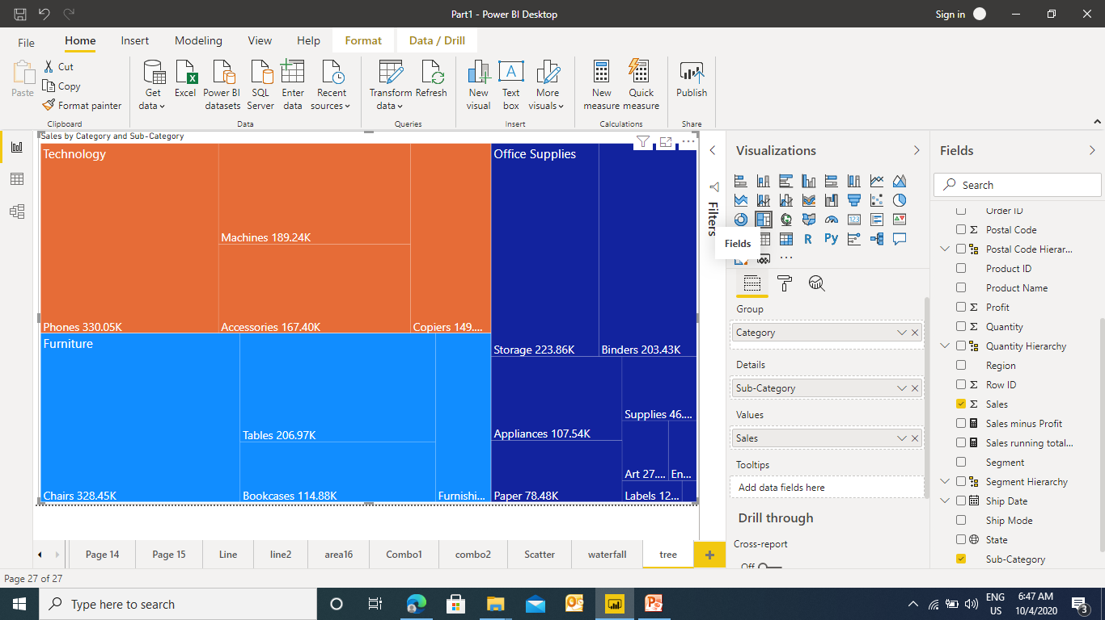
Tree Map in Power BI
Tree map displays the data in a form of boxes / rectangles of various size. These are useful to display a parent child relationship in the fields.

Slide 18
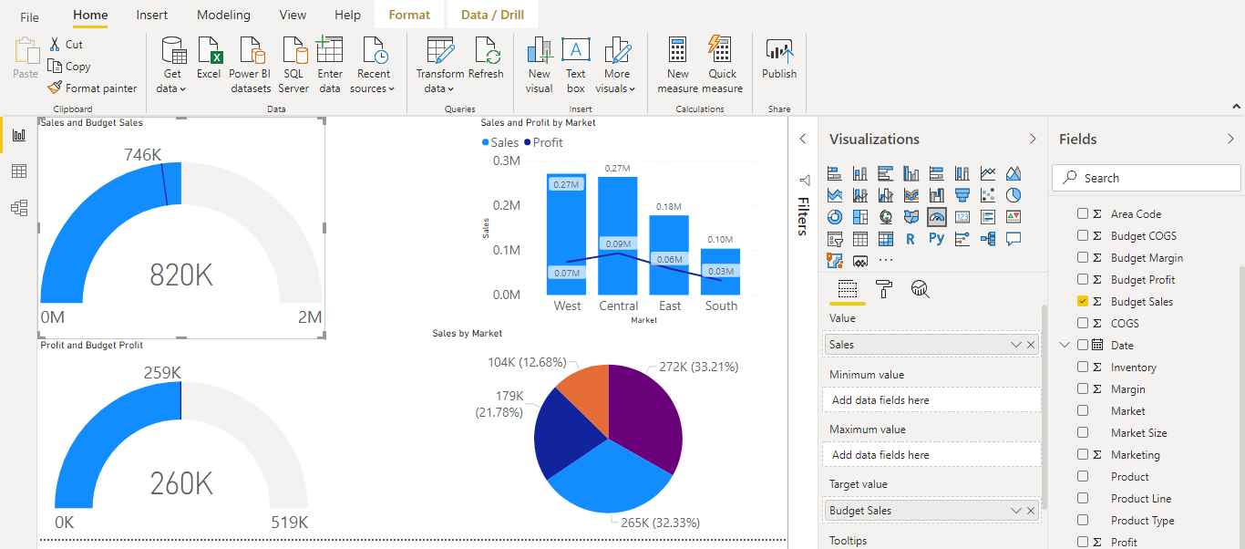
Gauge Chart in Power BI
A gauge chart is a half circle and shows a single value that measures progress toward a goal . The line (or needle) represents the goal or target value and the filled circle represents the actual value.

Slide 19
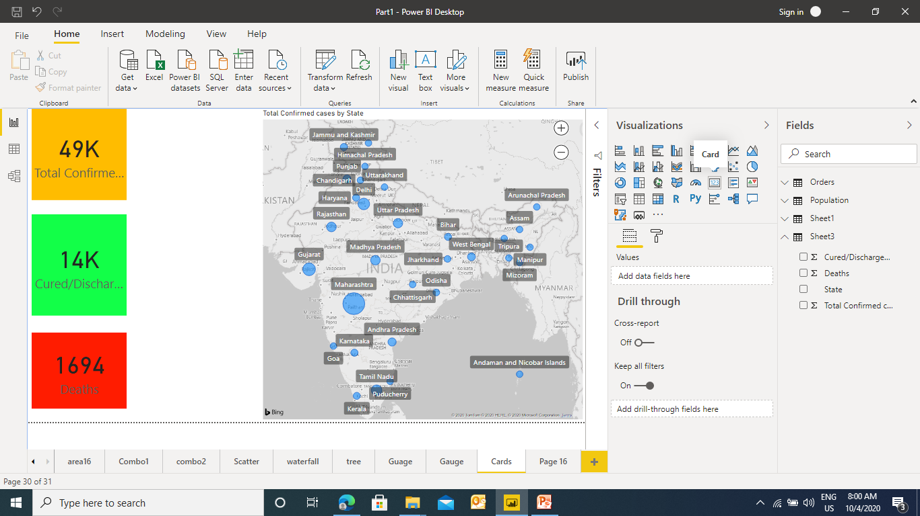
Cards in Power BI
Cards are the indicator which gives some value could be Number, Text Date .
Ex1 : Card with Numbers

Slide 20
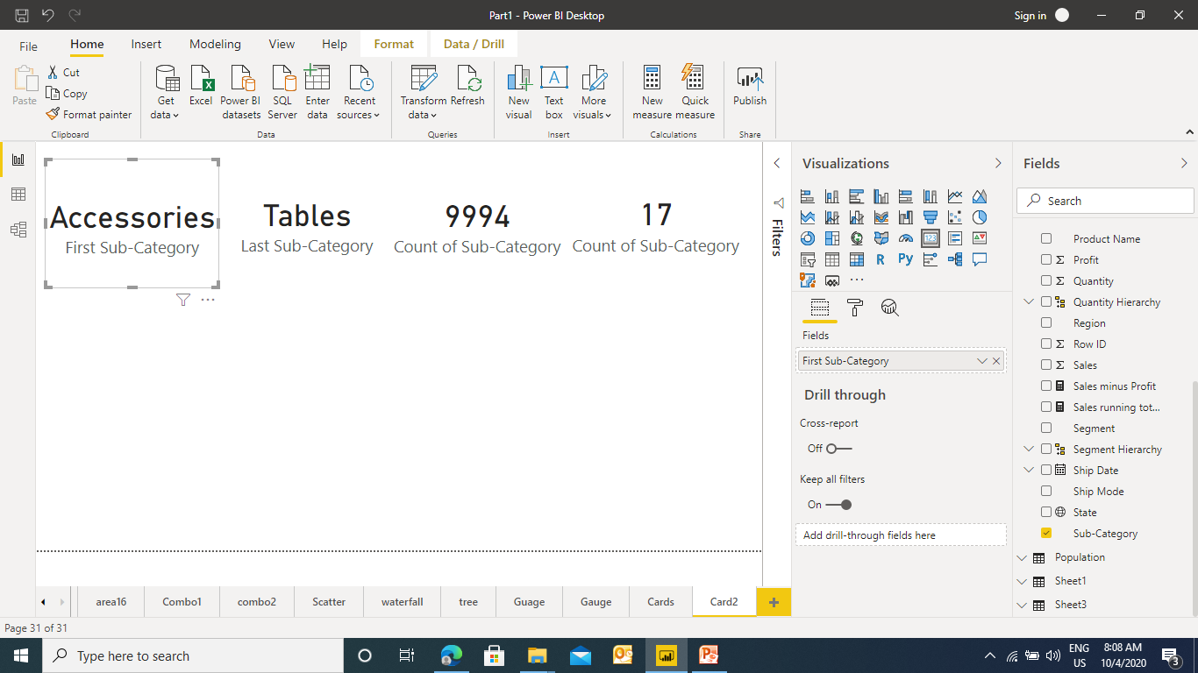
Cards in Power BI
Ex2 : Card with Text

Slide 21
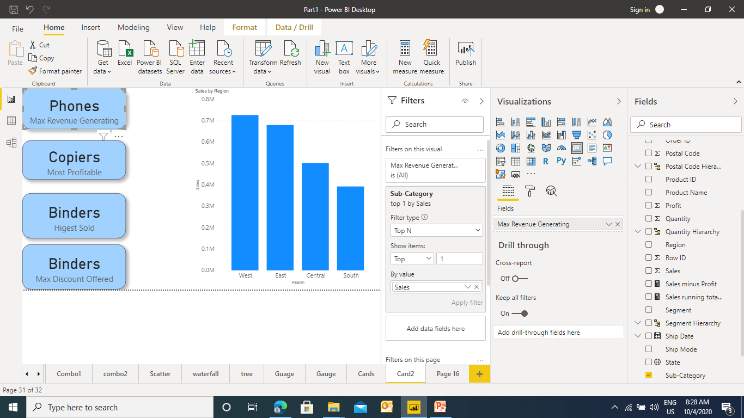
Cards in Power BI
Ex3 : Card with Dynamic Text

